Slide 1
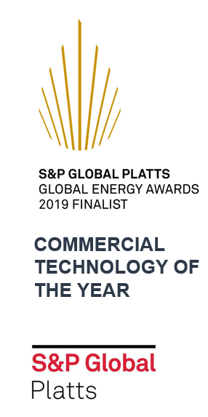
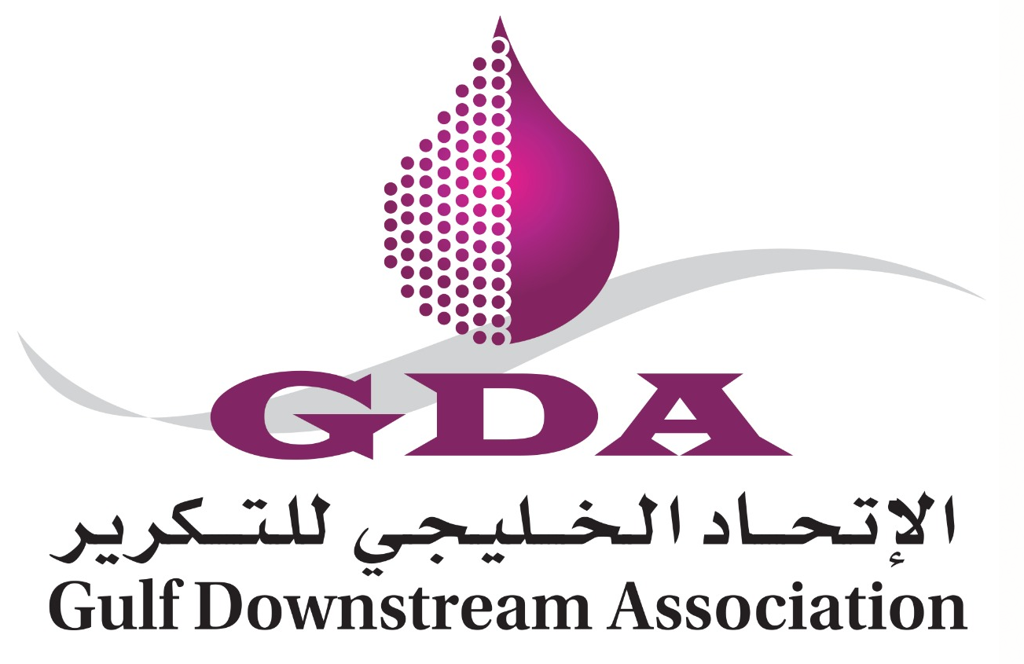
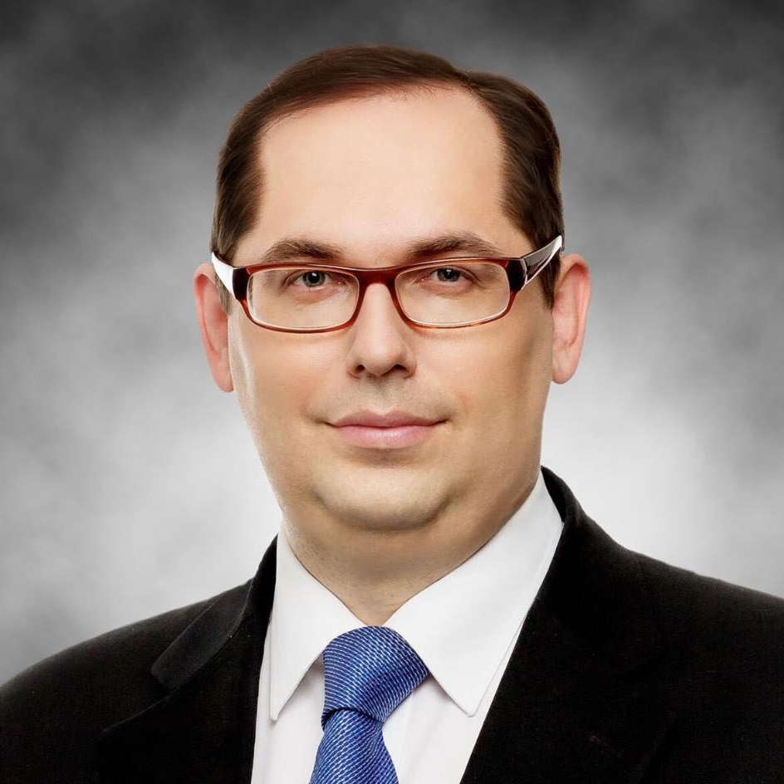
Uplifting refining margins through cognitive cleaning
Webinar
Enhance energy efficiency
Optimize costs
Reduce CO2 emissions
Moderator:
Speakers:
EMAD A. MUHAISEN
Ilya Rodin
Eduard Cherednik
Chairperson of Project Management Committee Division Head, Capital Efficiency Division – Saudi Aramco
CEO, Board Director
Chief Digital and Sustainability Officer

Slide 2
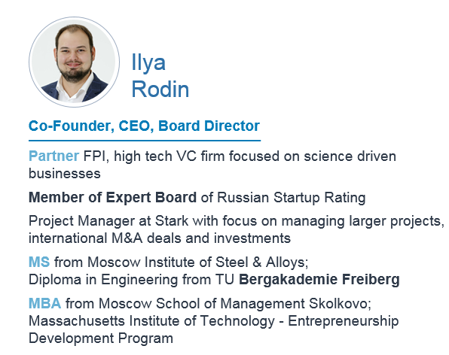
Uplifting refining margins through cognitive cleaning
Speaker

Slide 3
Uplifting refining margins through cognitive cleaning
Speaker

Slide 4
Uplifting refining margins through cognitive cleaning
Plan of Webinar
Item | By | Duration (Minutes)
Introduction | Emad | Done
Presentation | Ilia and Edward | 30
Q&A | Open | 20
Closing | Emad/Ilia/Edward | 5

Slide 5
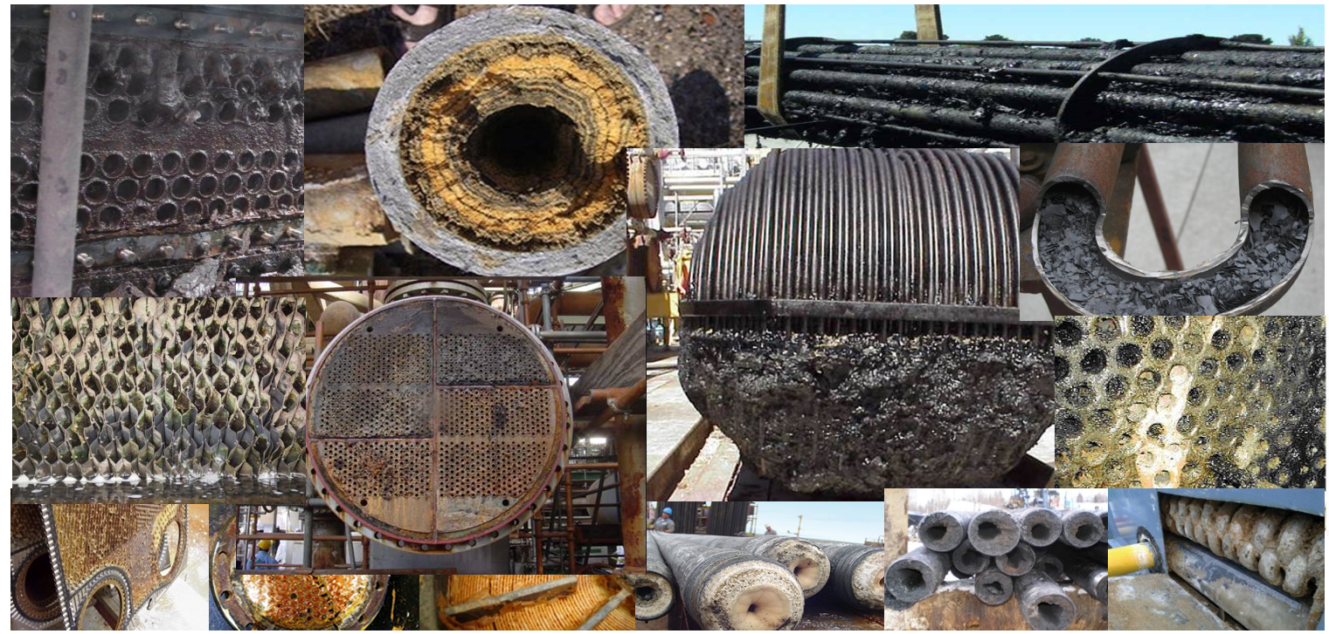
Decreased Product Circulation
Deficient Heat Transfer
… YOUR IMPORTANT EQUIPMENT GETS DIRTY WITH FOULING AND SCALE DEPOSITS
Notes:
You beautiful and very expensive equipment gets dirty and ugly.
Industrial business is not a beauty context, of course.
But here dirt means a decrease in efficiency
And the lower the efficiency the more money you lose.

Slide 6
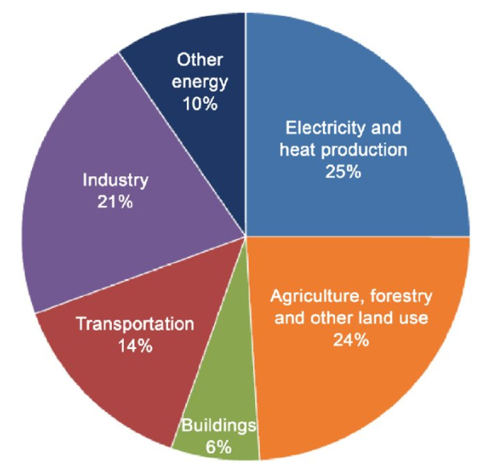
20% Fouling “Tax”
20% less CO₂ emissions from Chemical and Petroleum Refining
Savings
Fouling is a universal natural phenomenon of unwanted material on solid surfaces accumulation which heavily detriments energy efficiency and causes additional CO₂ emissions.
Preheating of inlet feedstock, fuel and air by hot products and waste
Fouling layer acts as insulator which reduces heat recuperation from hot products, product circulation and creates environment for corrosion
Refineries, petchem, power generation pay the “fouling tax”
Total CO₂ emissions: 33 billion tons

Slide 7
Fouling “tax”: model vs. actual CO2 emissions in petroleum refining, million tons
Emissions from the company report, mmtons CO2
Source: Angara analysis based on DOE, EIA, Solomon Associates, published research, companies reports

Slide 8
Fouling Impact Assessment: Petroleum Refining
Cost of fuel over-consumption due to fouling (billion USD)
 | Degradation of Heat Exchange
Petroleum Refining | Conservative | Baseline | Aggressive
 | 10% | 20% | 30%
Total North America | 1.1 | 2.2 | 3.4
Total S. & Cent. America | 0.3 | 0.5 | 0.7
Total Europe | 1.4 | 2.8 | 4.3
Total CIS | 0.5 | 1.0 | 1.5
Total Middle East | 0.5 | 0.9 | 1.4
Total Africa | 0.15 | 0.3 | 0.5
Total Asia Pacific | 4.0 | 8.1 | 12
MUSD: | 7.9 | 15.8 | 23.8
Fouling tax on global refining industry:
USD 15.8 bln. /year
Refining margin improvement:
USD 0.3 – 0.8 /bbl
Source: Angara model based on open sources analysis: DOE, EIA, Solomon Associates, published research, companies reports

Slide 9
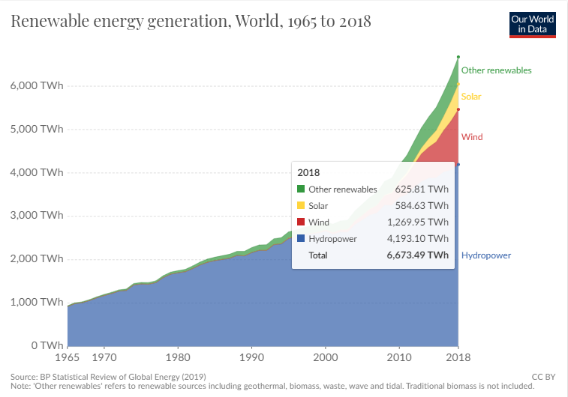
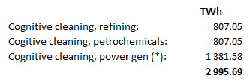
Industrial Hygiene Potential
Industrial Hygiene has a huge potential for refining, petrochemical and power generation industries. Potential is comparable with renewable energy:
1800 vs 1600 TWh
Note: the comparison between electric energy and heat energy savings is done to illustrate the opportunity potential

Slide 10
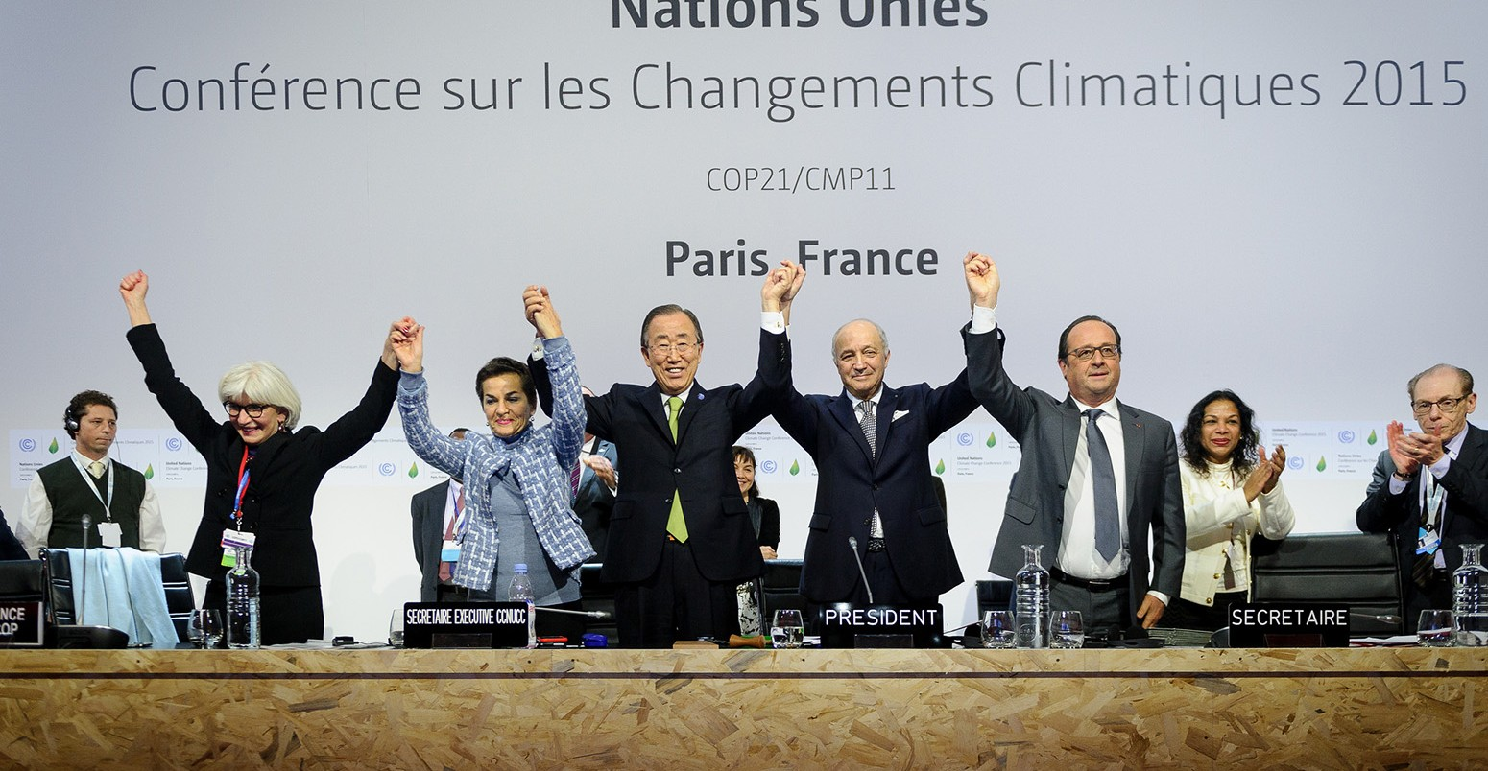
Industrial Hygiene contribution to the Global climate change
Industrial Hygiene has a potential to contribute 1/10 of climate 2⁰C goal set in Paris agreement without any capital investments

Slide 11
Angara can create billions of dollars of value for GCC
$2,500M
total positive economic value creation together with Oil & Gas Upstream & other industries
$1,079M
of annual gross benefit for Oil refineries
Mina Al Ahmadi
Shuaiba refinery
Aramco/Shell
New Refinery Project
Aramco/Sinopec
Sasref Jubail
Aramco
Country | Crude refining capacity kbbl/d | Current annual losses $ mln | Potential savings* $ mln
Saudi Arabia | 3,180 | 873 | 611
Bahrain | 260 | 73 | 52
Kuwait | 736 | 203 | 143
Oman | 533 | 147 | 104
UAE | 885 | 244 | 172
Total | 5,594 | 1,540 | 1,079
YASREF
Jubail
Ras Tanura
Aramco
Aramco
Aramco/Total
BAPCO
Takreer/ADNOC
Yanbu
Samref Yanbu
Ruwais Ref
Umm Al Nar Refinery
Sohar
ORPC
Aramco
ADNOC
Rabigh
Mina Al Fahal
Duqm
Aramco
ORPC/Petroleum Industries
IPIC/ORPC
Jeddah
Aramco
Jizan
Saudi Arabia
UAE
Oman
Bahrain
Kuwait
* Total possible AlfaPEROX related cost reduction/revenue maximization level is assumed 70%, i.e. how much losses can be recovered - gross (not including Angara and Service Providers part).
** Assumption: 2/3 of savings are retained by Clients (Oil refineries), and the rest, 1/3 of achieved savings, is split 50/50 between Service Providers (Angara Dealers) and Angara. In this estimate the net savings level for Customers is $719 mln
Only oil refining is estimated. Other potential highly probable revenue streams are not included in the current estimate
Source: BP Statistical Review 2017 for refining volumes and Abu Dhabi Emirates Statistics Centre for oil production (2016 data), Thompson Eikon and company data for refining capacities by company;
R. Steinhagen, H. Müller-Steinhagen, K. Maani Francesco Coletti, Geoffrey Hewitt, “Crude Oil Fouling: Deposit Characterization, Measurements, and Modeling”, 2014

Slide 12
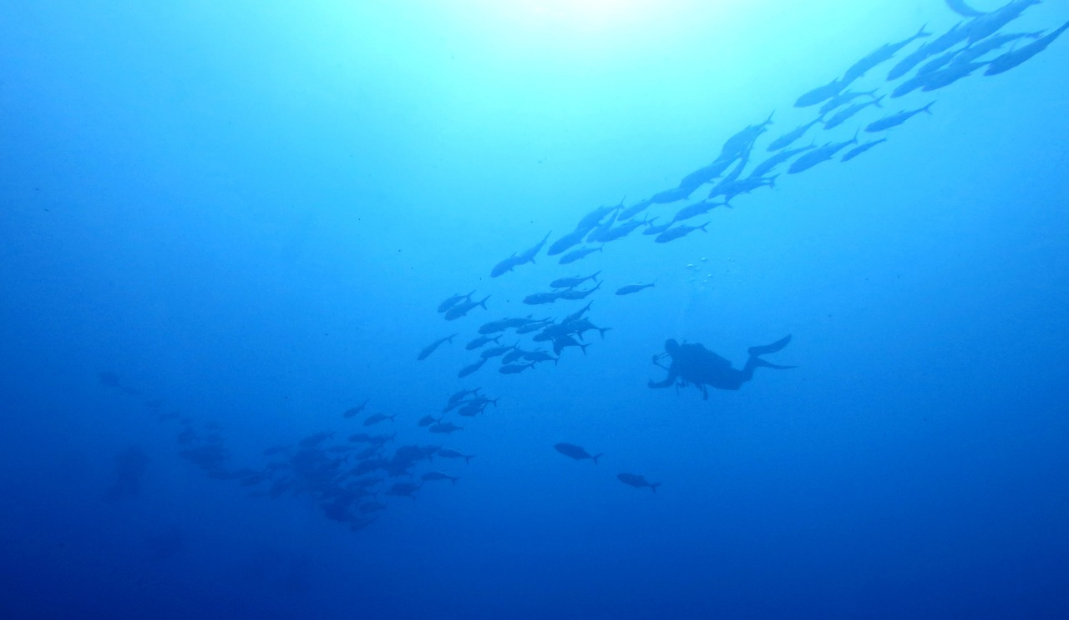
Explore a Blue Ocean of Opportunities with Angara
AlfaPEROXTM
Hardware Upgrade
Equipment Innovation Ultimate benefits maximization through use of the best available equipment maintained through cleanliness-as-a- service
Cleanliness-As-A-Service
Business Model Innovation Gain-sharing philosophy through a Service Level Agreement model to maintain enterprise cleanliness
Value for Business
Cognitive Cleaning™
Process Innovation Fusion of seamlessly integrated digital and chemical solutions for ultimate cleanliness management
AlfaPEROX™
Product Innovation A family of core cleaning solutions based on innovative fouling-tailored chemicals developed by Angara (‘Magic Bubbles’)
Innovation Degree

Slide 13
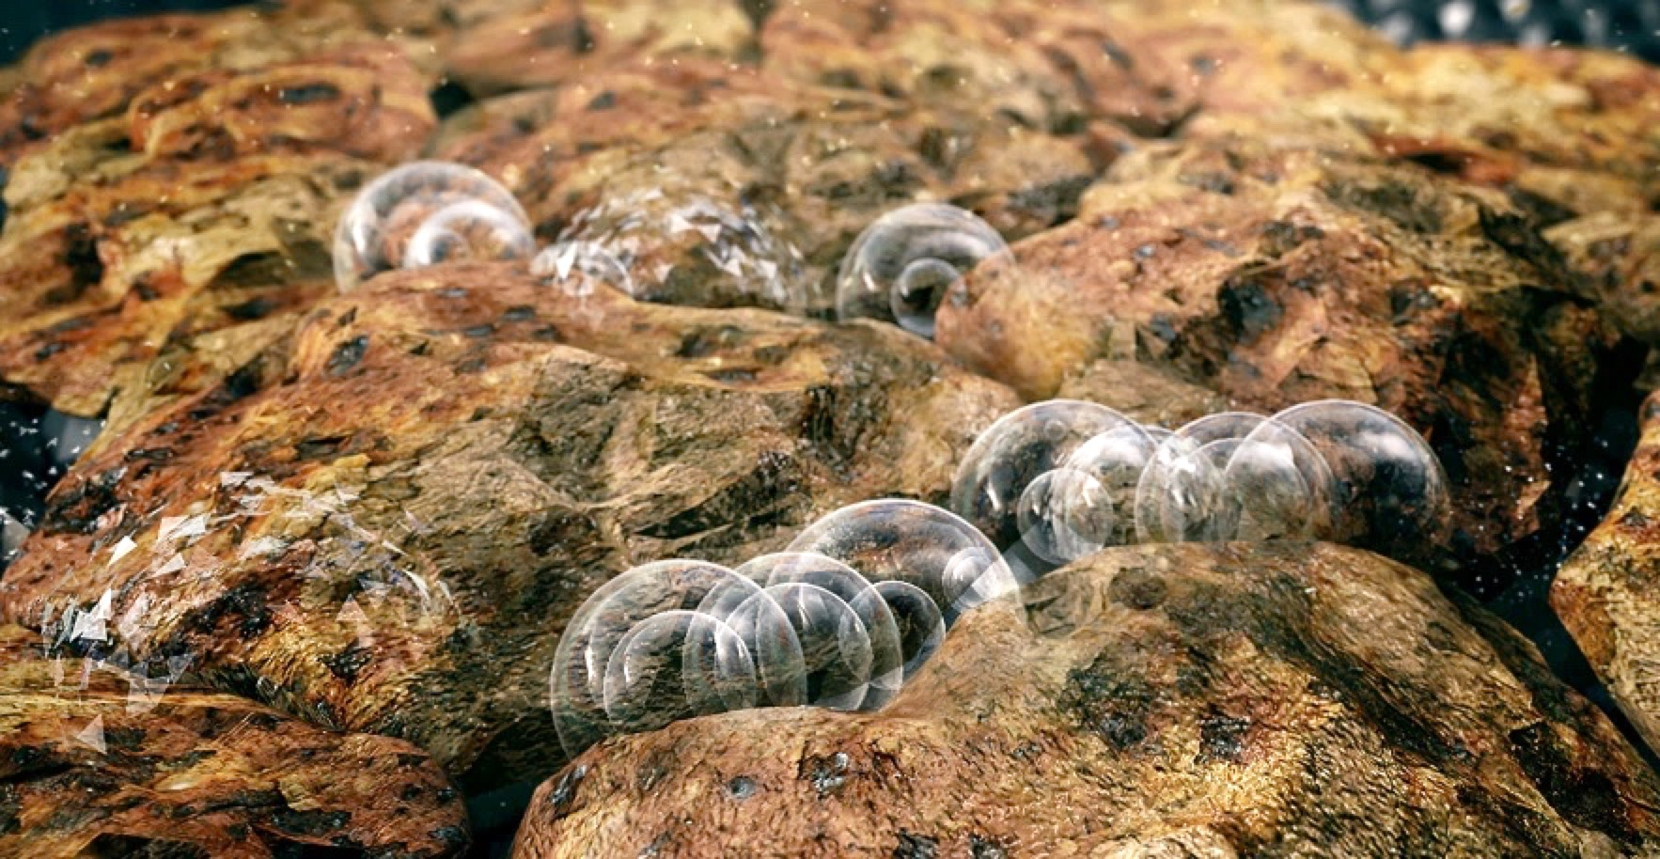
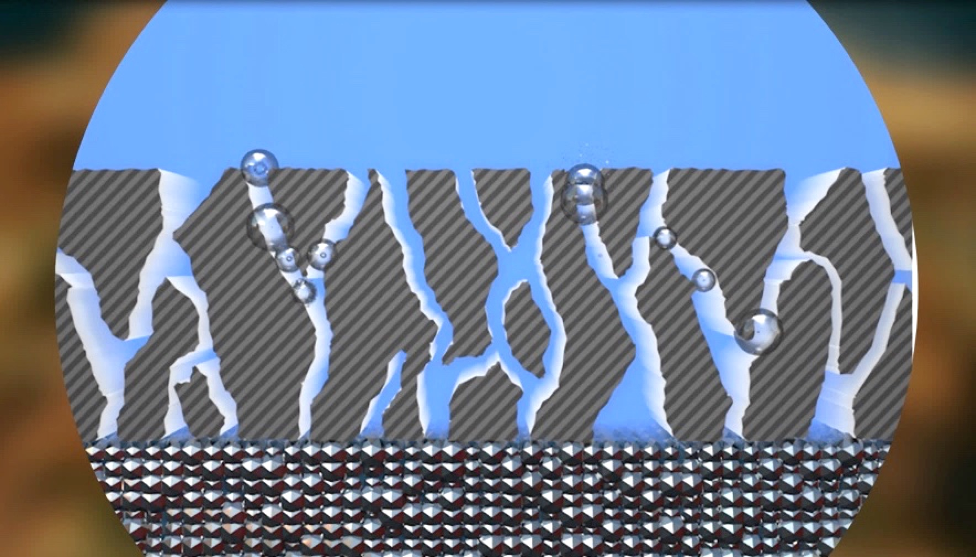
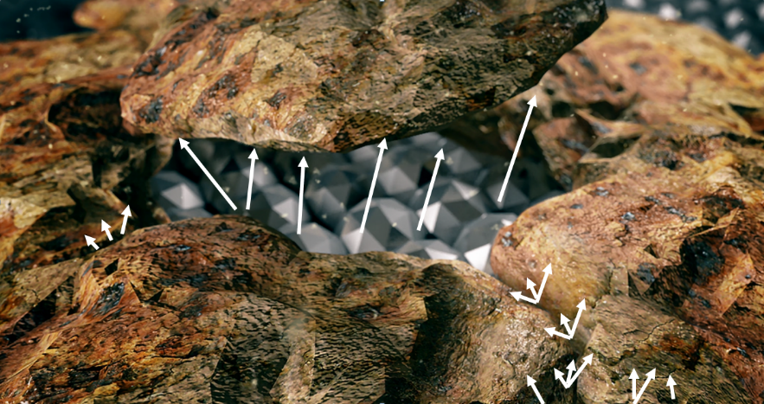
AlfaPEROX* is the key enabling technology of Angara
RECOGNIZED BY WORLD EXPERTS**
HOW IT WORKS
Finely controlled release of bubbles – in the right time, in the right place:
Peroxide gets decomposed into H2O and O2 inside the pores and cracks of fouling
Released O2 expands and applies pressure inside the fouling
The pressure mechanically removes fouling from inside
** Additional info:
https://www.spglobal.com/platts/global-energy-awards/finalists
Patented technology
* AlfaPEROX is proprietary patented technology developed by Angara Industries
Notes:
We named our key smart chemistry based technology AlfaPEROX.
It works in a very simple way.
In a nutshell we harnessed the power of oxygen bubbles that get released when Hydrogen Peroxide reacts and gets decomposed into water and oxygen.
And our job is to get this done in the right time, in the right place.
We developed a process technology to tightly control the decomposition of peroxide.
We inhibit it first, get it into cracks and pores of fouling inside heat exchangers, and start the decomposition reaction there.
The released O2 is gas, gas expands, and applies pressure to the walls of the cracks and pores. So that it disrupts the upper layers of fouling with this pressure.
We wash it by circulating AlfaPEROX, and remove fouling – layer by layer.
It easy to say, difficult to do.
Of course, there’s lots of Know How and the technology is protected by patents internationally.

Slide 14
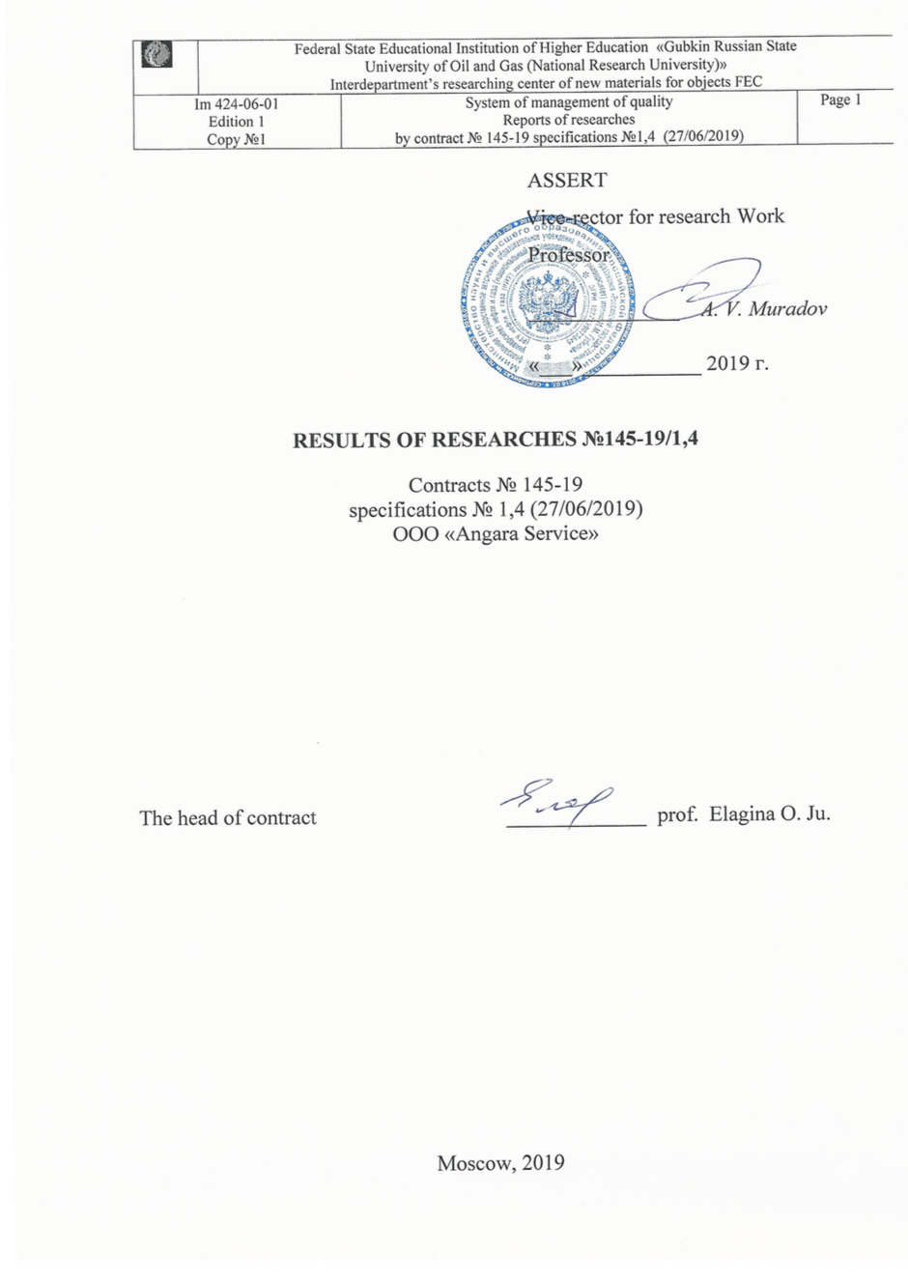
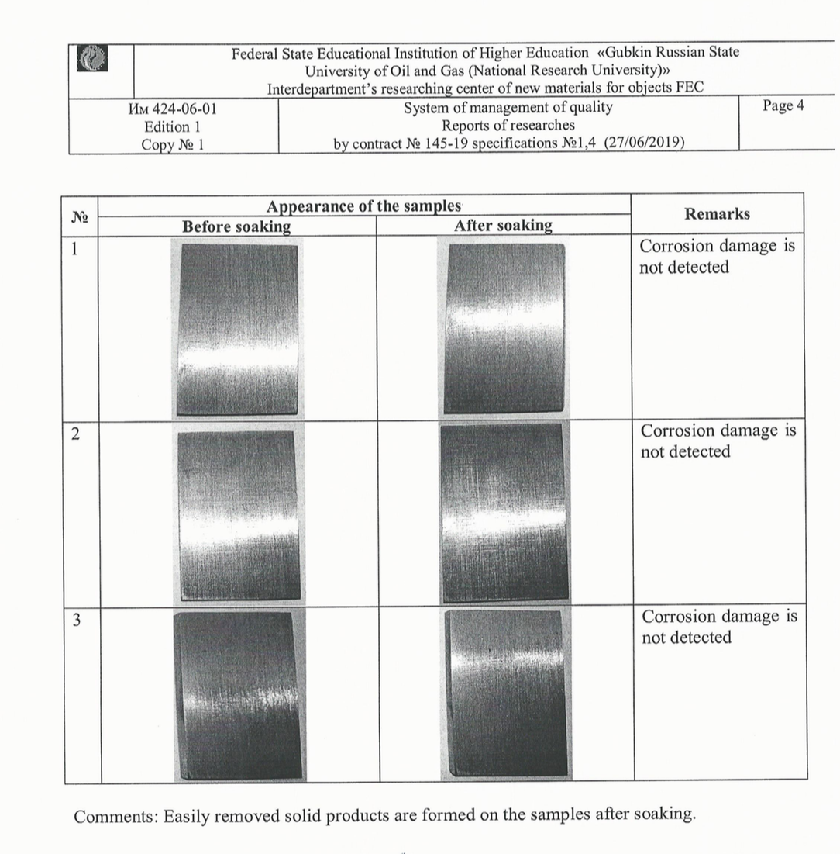
Corrosion report
Equipment safety is ensured

Slide 15
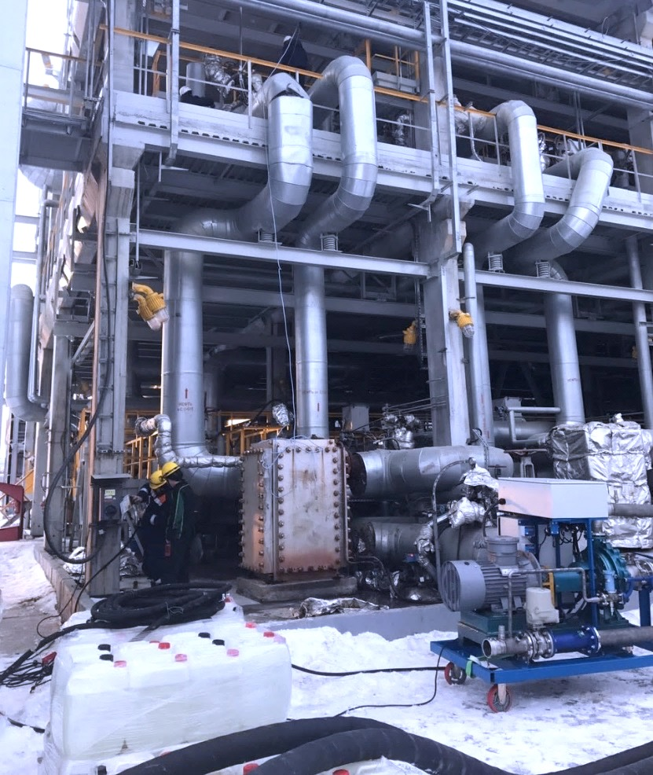
Case study: TANECO Refinery 280 kbbl/d
Heat exchanger: plate heat exchanger Alfa Laval CPK75-V- 150PLS at VDU. Medium is tar at hot side and crude oil at cold side. Volume is 0.6 m3 each side.
Fouling: Deposits at both sides are products of thermal destruction of crude oil and tar, crude oil coke and pyrocoke. Deposit thickness is 2 mm.
Alfa Laval
Compabloc
AlfaPEROX
Pumping unit

Slide 16
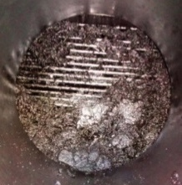
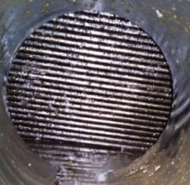
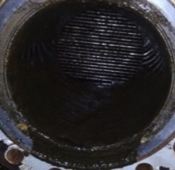
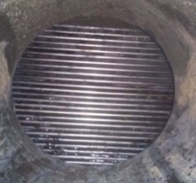
Case study: TANECO Refinery 280 kbbl/d
Before
After
Measured parameter | Before | After
Pressure gradient, MPa | 0.35 | 0.2
Temperature gradient, °С | 9 | 65
Free volume, m³ | 0.46 | 0.59
Hot (tar)
Measured parameter | Before | After
Pressure gradient, MPa | 0.31 | 0.1
Temperature gradient, °С | 42 | 70
Free volume, m³ | 0.52 | 0.6
Before
After
Cold (oil)
21.1 GJ/h is required to compensate inefficiency of 1 foul heat exchanger. More gas needs to be burnt (instead of being sold)

Slide 17
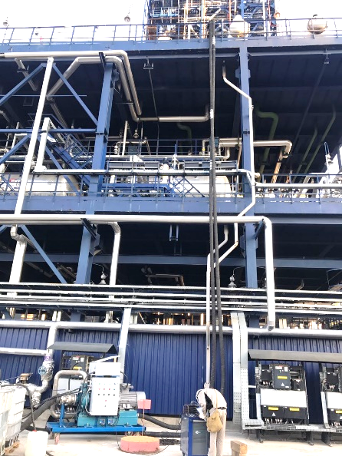
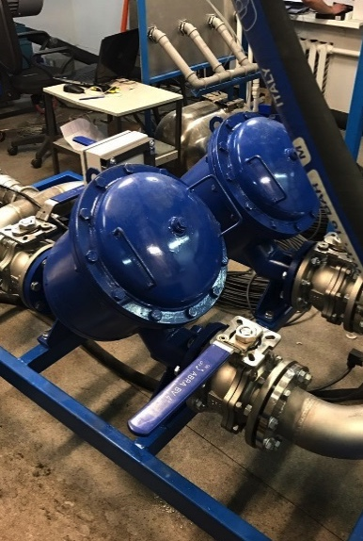
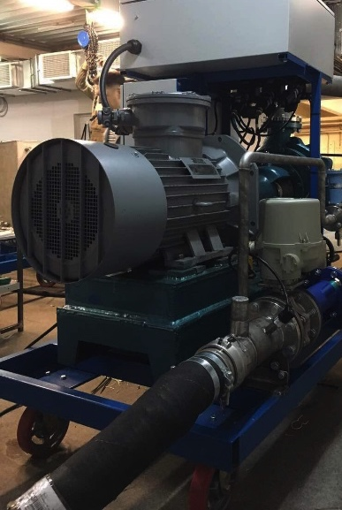
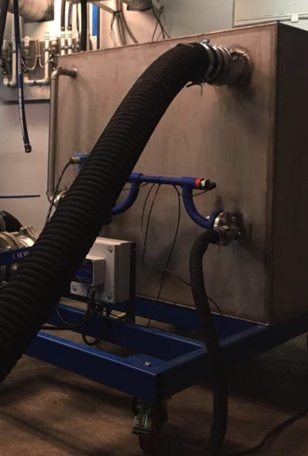
Case study: GAZPROMNeft Refinery 250 kbbl/d
All are on the customer site, connected to electricity, water, sewage and heat exchanger.
The heat exchanger on its place 16 meters above the ground.
Two shifts by 12 hours complete the job in the next 23 hours
Butane cooler (Heat exchanger)
Cleaning module complies with requirements: ТР ТС 012/2011 and explosion-proof standard: Ex II Gb c IIA T6
Cleaning module
Filter section
Pump section
Buffer tank

Slide 18
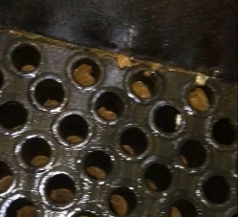
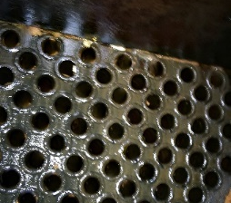
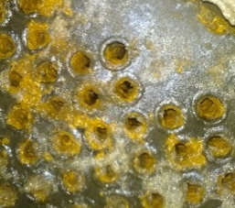
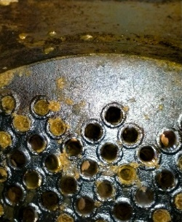
Case study: GAZPROMNeft Refinery 250 kbbl/d
Cold loop (inlet)
Before
After
AlfaPEROX cleaning efficiency was assessed by:
Thermometers installed on heat exchanger that measured temperature gradient before and after cleaning
Monometers installed on cleaning modules that measured pressure gradient before and after cleaning
Visual check
Cold loop (outlet)
Before
After
Options: | Mechanical | AlfaPEROX
Duration | 72 h | 23 h
Cleaning cost | $20 000 | $50 000
Revenue loss | $180 000 | $60 000
Combined cost | $200 000 | $110 000
Savings per 1 cooler per 1 cleaning | 0 | $90 000
Temperature gradient of n-butane , ˚C
 | Before | After
Т inlet | 62,4 | 61,1
Т outlet | 61,5 | 21,8
ΔT | 0,9 | 39,3
Economic Value Creation
AlfaPEROX saves ca. 45% of conventional cleaning costs

Slide 19
Explore a Blue Ocean of Opportunities with Angara
Cognitive CleaningTM
Hardware Upgrade
Equipment Innovation Ultimate benefits maximization through use of the best available equipment maintained through cleanliness-as-a- service
Cleanliness-As-A-Service
Business Model Innovation Gain-sharing philosophy through a Service Level Agreement model to maintain enterprise cleanliness
Value for Business
Cognitive Cleaning™
Process Innovation Fusion of seamlessly integrated digital and chemical solutions for ultimate cleanliness management
AlfaPEROX™
Product Innovation A family of core cleaning solutions based on innovative fouling-tailored chemicals developed by Angara (‘Magic Bubbles’)
Cleanliness Lab
A virtual or established entity where a joint and co-located team drives cleanliness transformation program:
Innovation Degree

Slide 20
Cognitive Cleaning Framework
Automotive
Fouling deposits vary from one heat exchanger to another due to a number of factors.
Therefore, the cleaning solution is always tailored to each specific heat exchanger.
Cognitive Cleaning improves the key components of Solomon’s Index:
Mechanical availability
Personnel Index
Energy Intensity Index
Governments
Technology Leaders
Electronics
Airspace & Defense
Smart Recipe
Fouling Characterization
Partners
Recipe and Samples Repository
International Organizations
Chemicals Partner
Digital Twin Partners
Healthcare
Oil and Gas
Thought Leaders
Cognitive Cleaning
Smart Cleaning
Smart Maintenance
Manufacturing
Service Providers
Cleaning Partners
Cleanness Lab Partners
Cognitive Cleaning allows to:
uplift the refining margin by USD 0.3 – 0.8 /bbl
to reduce CO2 emissions by 15 - 20%
Scientists
Mining
Maritime
This presentation may contain privileged and/or confidential information, and is intended to be received only by persons entitled to receive such information. If you have received this presentation in error, please notify the sender immediately.
Please delete it and all attachments from any servers, hard drives or any other media. Other use of this presentation by you is strictly prohibited.

Slide 21
Refining margins uplift with no CAPEX
Illustrative example
Cognitive Cleaning
Relative heat transfer efficiency
New average efficiency level
100%
100%
75%
75%
Significant losses
Significant savings
50%
50%
Average efficiency level
25%
Conventional periodic maintenance
during shutdowns
25%
Plant Shutdown
Plant Shutdown
Plant Shutdown
Plant Shutdown
Months
0
12
Months
0
12
Double effect: Higher margins + Lower CO2 emissions

Slide 22
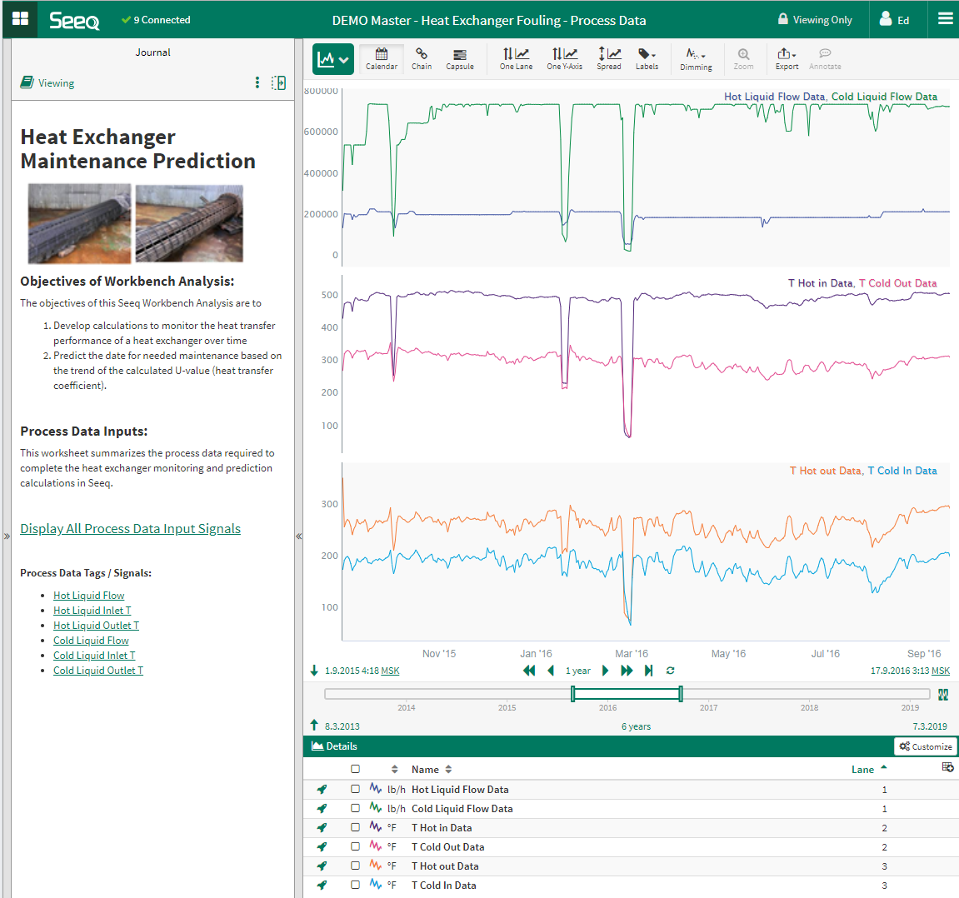
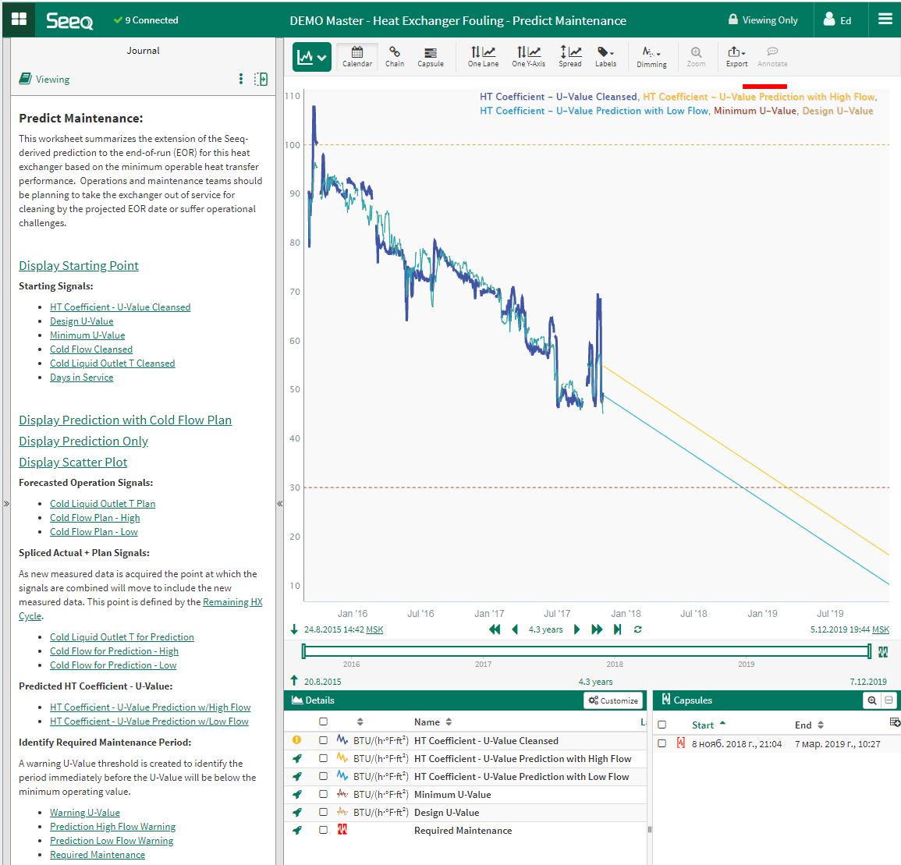
HEX monitoring system: SEEQ realization

Slide 23
Explore a Blue Ocean of Opportunities with Angara
Cleanliness-As-A-Service
Hardware Upgrade
Equipment Innovation Ultimate benefits maximization through use of the best available equipment maintained through cleanliness-as-a- service
Cleanliness-As-A-Service
Business Model Innovation Gain-sharing philosophy through a Service Level Agreement model to maintain enterprise cleanliness
Value for Business
Cognitive Cleaning™
Process Innovation Fusion of seamlessly integrated digital and chemical solutions for ultimate cleanliness management
AlfaPEROX™
Product Innovation A family of core cleaning solutions based on innovative fouling-tailored chemicals developed by Angara (‘Magic Bubbles’)
Innovation Degree
23

Slide 24
Cleanliness Lab: Managed service
“Cleanliness Lab” – is a new paradigm of maintaining cleanness of heat exchangers. Instead of running dirty equipment in between of shutdowns Cleanliness Lab maintains HEX clean all the time.
Angara may become a partner who shares economical risks of cleaning effectiveness or even own heat exchangers!
In this case Angara’s compensation directly linked to the cleaning effects. Level of service is ensured by typical Service Level Agreement (SLA).
Traditional approach
Conflict of goals
Managed Service
Common goals
Contractor
Customer
Partner
Customer
Cost of materials (price, volume, etc.)
Shared costs/benefits (efficiency, CO2, non-productive time)
wants to increase
wants to reduce
wants to reduce
wants to reduce
Reduced costs, risks and environmental footprint
To unlock full potential of SLA model for heat exchangers it is required:
energy efficiency long-term contracts
seamless integration of digital and cleaning solutions

Slide 25
Explore a Blue Ocean of Opportunities with Angara
Hardware Upgrade
Hardware Upgrade
Equipment Innovation Ultimate benefits maximization through use of the best available equipment maintained through cleanliness-as-a- service
Cleanliness-As-A-Service
Business Model Innovation Gain-sharing philosophy through a Service Level Agreement model to maintain enterprise cleanliness
Value for Business
Cognitive Cleaning™
Process Innovation Fusion of seamlessly integrated digital and chemical solutions for ultimate cleanliness management
AlfaPEROX™
Product Innovation A family of core cleaning solutions based on innovative fouling-tailored chemicals developed by Angara (‘Magic Bubbles’)
Innovation Degree

Slide 26
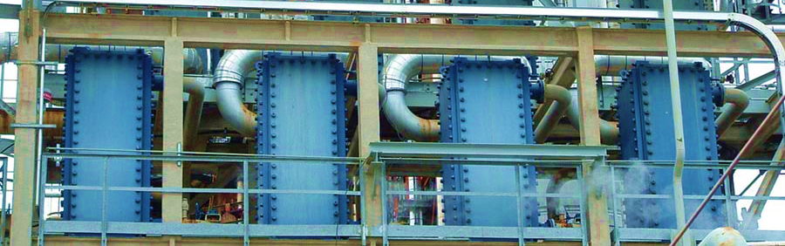
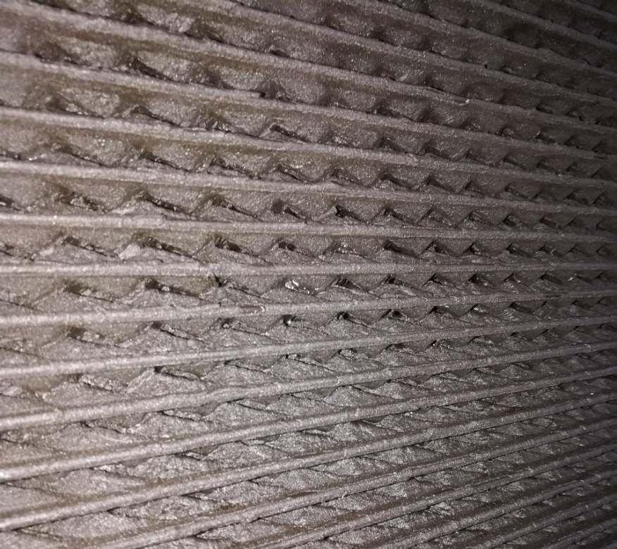
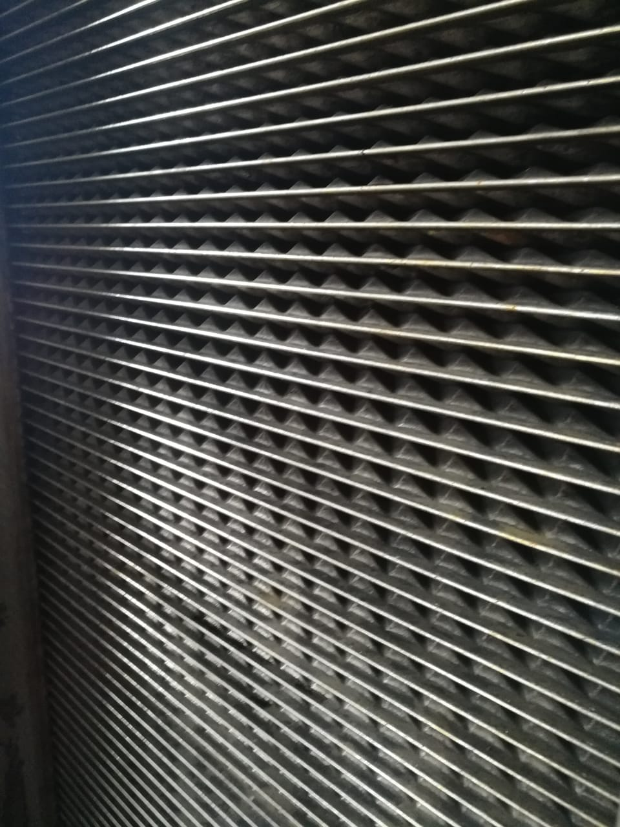
Refinery Hardware Upgrade case Complete preheat train at refinery: 26 Plate Heat exchangers Nexson
One of the largest refineries in Russia
PHT CDU: 100 kbbl/day
Great performance
Great maintenance challenges
Cleaning result:
Pressure drop reduction by 45-84%
Tar exit temperature reduction by 30˚
Before
After

Slide 27
Refinery Hardware Upgrade case Pre-Heat Train Energy Intensity at the Refinery
BTU / barrel
% fouling-driven energy losses | Current Typical Energy Intensity | State of art Refineries | Practical minimum | Thermodynamic minimum | Referenced Refinery with Plate HEXs
Clean HEX | 98 190 | 84 870 | 56 700 | 34 000 | 58 000
10% | 109 100 | 94 300 |  |  | 63 800
20% | 120 010 | 103 730 |  |  | 69 600
****
*
**
***
*
Current Typical assumes 10% case
**
***
U.S. DOE 2015
****
U.S. DOE, 2007
LBNL 2005a; SEP 2013; DOE 2013; ExxonMobil 2013; McKinsey 2009; LBNL 2005b; Tarighaleslami et al. 2011; Zhang et al. 2012; Varga et al. 2010; Bulasara et al. 2009; Kumana & Associates 2013
Project data
Modern hardware and “Clean-as-you-go” service model empowered over 42% fuel and CO2 reduction (~130 000 tons CO2 per year on a 100 kbbl/day CDU)
Source: U.S. Department of Energy, 2015: Appendix А1, Bandwidth Study on energy Use and Potential Energy Saving Opportunities in U.S. Petroleum Refining

Slide 28
Q&A
20% fouling tax
Hygiene Potential for climate
Hygiene Potential for GCC
What ?
Product Innovation
Process Innovation
Hardware Innovation
How ?

Slide 29
Uplifting refining margins through cognitive cleaning
Closing
We hope that we together have made this webinar interactive and useful that each one of us will take away something which can further develop the industry and complement our business interests.
Stay Safe and wish you healthy life

Slide 30
Cognitive Cleaning
Appendix
Petroleum
Downstream

Slide 31
Environment Impact Assessment: Fouling in Petroleum Refining
BP Statistical Review of Global Energy, 2019
Energy Information Administration, Refinery Capacity, 2019
Department of Energy, US: Bandwidth Study on Energy Use, Petroleum Refining
US National Institute of Standards and Technology
UK Petroleum Industry Association
Data Sources
Model
Energy Balance: Current Typical Values for U.S. refineries in 2010 is used (most recent available by U.S. DOE)
Thermodynamics similarity criteria of flows that characterize fouling deposits in processes
Key nine refining processes modeled (atmospheric distillation, vacuum distillation, fluid catalytic cracking, etc.)
Results
Global refining process energy consumption for conservative, baseline and aggressive cases, by country
Global CO₂ emissions assessment, by country
Global fouling-driven CO₂ emissions, by country
Global fouling-driven economical cost model, by country (fuel perspective)

Slide 32
Simple Assessment Model – Three Steps
1
Calculate CO₂ emissions with clean Heat Exchangers
Btu / bbl of crude
Refining Process Energy Intensity
kgCO₂ / Btu
Fuel Emission factor
bbl / day
Refining Volume
kgCO₂ / day
CO₂ emissions
*
*
=
2
Model Degradation of Heat Exchangers
Degradation of Heat Exchangers due to fouling reduces amount of energy transferred from hot products and waste to preheat inlet cold feedstock. This energy should be added by fire-heaters by burning extra fuel and emitting extra CO₂. The model considers three cases: 10%, 20% and 30% HEX degradation by increasing Energy Intensity of corresponding refining processes.
3
Using regional and country data from BP Statistical Review of Global Energy, 2019 and adjustment for refining complexity to produce CO₂ emissions, economics and fuels consumption for clean, 10%, 20%, 30% cases. Open source data cross-check to confirm the base case.
Global case
32

Slide 33
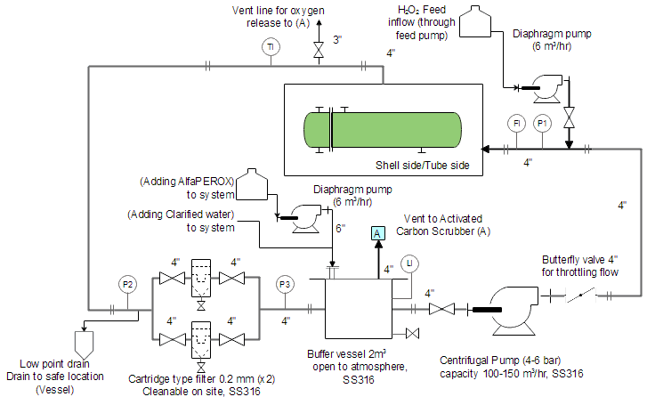
1. Preparation
Operating guideline
Air Relief Valve
Atmospheric Valve
1.1 Connect skid to HEx.

Slide 34
2. Leak test
Operating guideline
Air Relief Valve
Atmospheric Valve
2.1 Filled clarified water in buffer vessel. Monitor and measure by the water counter device the amount water in the system.
2.2 Pumping water into system stepless increasing of pump output. Take care about air relief in the high point of HEx

Slide 35
3. Drain water
Operating guideline
Air Relief Valve
Atmospheric Valve
3.1 Drain the water to waste tank.
3.2 To ensure and accelerate drainage use the pressurized nitrogen if possible.

Slide 36
4. Adding AlfaPEROX™-1
Operating guideline
Air Relief Valve
Add AlfaPEROX™ 1
Atmospheric Valve
4.1.Filled AlfaPEROX™-1 to system in calculated amount (p.2)
4.2 Pumping solution into system stepless increasing of pump output. Take care about air relief in the high point of HEx
.

Slide 37
5. Circulation
Operating guideline
Air Relief Valve
Atmospheric Valve
5.1 After completely add AlfaPEROX™-1, circulate for specified time (measure the pressure every 15 minutes).

Slide 38
6. Drain AlfaPEROX™-1
Operating guideline
Air Relief Valve
Atmospheric Valve
6.1 Stop pumping (if needed) and drain all AlfaPEROX™-1 to waste tank or storage tanks for further utilization.
6.2 To ensure and accelerate drainage use the pressurized nitrogen if possible

Slide 39
7. Add AlfaPEROX™- 2 & H₂O₂
Operating guideline
Air Relief Valve
Add H2O2
Add AlfaPEROX™- 2
Atmospheric Valve
7.1 Fill water in the system. And then Drain water in a volume 14% of total amount.
7.2 Add AlfaPEROX™-2 in corresponded amount. And circulate for 40 minutes.
7.3 Stop the circulation. Add H2O2 in line near HX as close as possible.
7.4 Wait for the extinction of the reaction (about 40 min). Ensure the periodic gas relief in highest point.

Slide 40
8. Circulation
Operating guideline
Air Relief Valve
Temp should not exceed 60 ºC
Atmospheric Valve
8.1 Start circulate for 60 minutes with periodic gas relief

Slide 41
9. Drain solution
Operating guideline
Air Relief Valve
Atmospheric Valve
9.1 Drain all solution to waste tank.
9.2 To ensure and accelerate drainage use the pressurized nitrogen if possible

Slide 42
10. Water flushing
Operating guideline
Air Exhaust Valve
Air Relief Valve
Atmospheric Valve
10.1 Filling the system with water and circulate 20 mins.
10.2 Monitor and measure by the water counter device the amount water in the system

Slide 43
11. Drain solution
Operating guideline
Air Relief Valve
Atmospheric Valve
11.1 Drain the flushing water to waste tank.
11.2 To ensure and accelerate drainage use the pressurized nitrogen if possible.

Slide 44
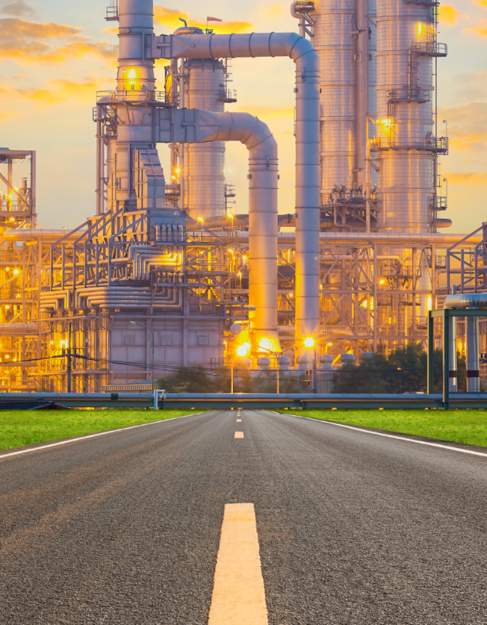
Roadmap
Creating Real Value
Fouling Samples Analysis in Angara lab. Efficiency and Corrosion tests
AlfaPEROX on-site trial
Data availability and sensors installation check
Cognitive Cleaning model finetuning
One-year Cognitive Cleaning Trial
Done
This presentation may contain privileged and/or confidential information, and is intended to be received only by persons entitled to receive such information. If you have received this presentation in error, please notify the sender immediately. Please delete it and all attachments from any servers, hard drives or any other media. Other use of this presentation by you is strictly prohibited.

